Slide 1
LIFT Ecosystem Accelerator Program (LEAP 2024)
Project Call
Rev. 1
DEV 6/23/2023

Slide 2

Instructions
Complete the attached forms to submit your project:
Include proposed budget (Maximum $250,000 from LIFT) and timeline (6 months)
Projects will be evaluated on:
    Technological Merit
    Technology MRL level
    Program Timing
    Funding Requirement
    LIFT Member Engagement
    Planned use of LIFT’s High-Bay Equipment
    Cost Share Commitment
Submit completed forms to https://lift.technology/project-calls/
Click to register for LIFT’s Q&A Sessions:
    August 22, 2024: 1:00 p.m. – 2:00 p.m. ET
    August 29, 2024: 1:00 p.m. – 2:00 p.m. ET

Slide 3
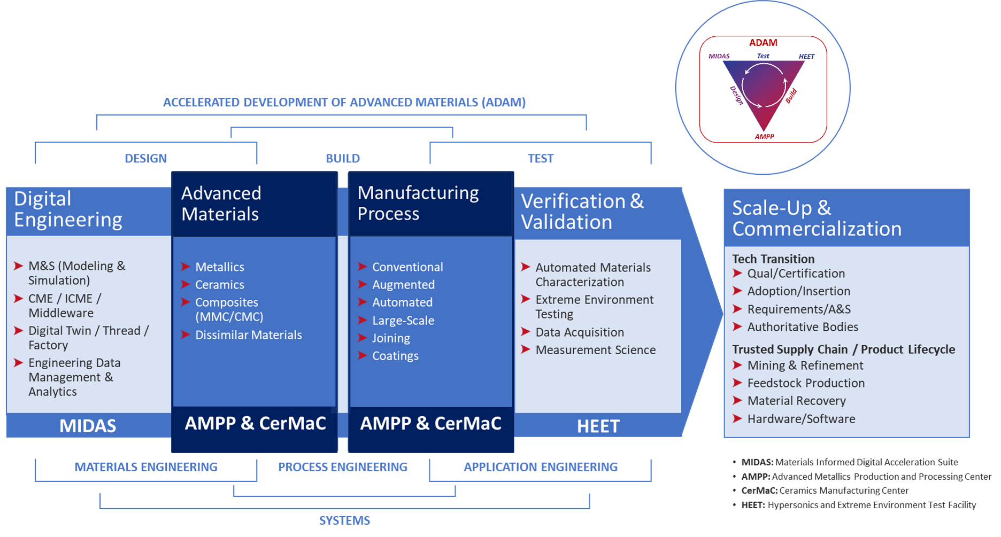
LEAP 2024
Project Summary
Open to all LIFT members
  Awardee must be a LIFT Silver Member or higher tier
  All project consortium members must be a LIFT member in good standing for award
  Non-members may submit proposals but must join membership to minimum Silver tier upon selection
Subject(s) must be aligned with the LIFT Technology Pillars
Subject(s) defined by six (6) topics

Slide 4
LEAP 2024
Project Timing
LIFT Highbay Support Quote Deadline: September 11, 2024
Proposal Deadline: October 11, 2024
Initial Project Selection: November 2024
Subawards contracting starts: November 2024
Projects must be completed by July 25, 2025
  Max six (6) month project duration
  Final report due August 25, 2025
Debrief to non-awardees: January 2025
  Including discussion regarding further developing project ideas into “white papers” for submission in future proposals

Slide 5
LEAP 2024
Project Funding
  Max $250,000 LIFT contribution per project
  Minimum industry cost-share 25% of LIFT contribution to project
    i.e., If Total Project Value (TPV) = $333.3K, LIFT contribution of $250K with the minimum cost share of $83.3K
  When multiple SILVER or higher tier members submit a joint proposal, the LIFT maximum contribution (of $250K per SILVER or higher member) will be combined.
    i.e., If say three (3) SILVER or higher tier members submit a consortium proposal, the LIFT maximum will be considered $750K, with the associated minimum cost share of $250K
Cost-share (recommended at 1:1) is recommended and strongly considered in project selection
  Award will be cost reimbursable – no fee
  Not to Exceed amount of LIFT award
  To be billed on a monthly basis as costs are incurred
  Fully burdened cost proposal required at submission deadline

Slide 6
LEAP 2024
Decision Criteria
  Technological Merit
  Aligned with project topics
  Aligned with LIFT pillars
  Technology Readiness Level / Manufacturing Readiness Level
  MRL and/or TRL 4-7 Only (below 4 and above 7 disqualified)
  Moves the TRL and/or MRL by 1 or 2 points
  Funding Request
  Cost Share Commitment
  Including services, materials etc.
  LIFT Member Engagement
  LIFT Silver Member or higher
  LIFT Ecosystem Involvement
  Use of LIFT High-Bay and Equipment
  https://lift.technology/facilities/

Slide 7

LEAP 2024
Topics for LEAP 2024 Project Call
  High Throughput Alloy Synthesis And Test
  Automated metallography and analysis
  Chemical analysis
  Extreme Environment Performance Testing
  Hot structure
  Thermochemistry
  Aerothermodynamics
  High Strain Rate
  Virtual Representation Of Materials In Extreme Environments
  Crack growth in homogenous materials
  Gun-barrel interactions
  High Strain Rate, e.g., Ballistic impact
  High enthalpy e.g., Hypersonics
  Digital Augmentation Of Manufacturing Processes
  Digital Twin (Materials, Processes, and Systems)
  In-situ monitoring
  Process modeling
  High Temperature Materials
  Metallics, MMCs, Ceramics, CMCs
  ICME for Ceramics and CMCs (chemistry, process, structure, performance)
  Joining, including dissimilar materials
  Cost effective, scalable, refractory metal processing
  Hydride – dehydride
  Alloying
  Materials Maturation
  Design for materials recovery
  Critical element reclamation
  Displacement/replacement of critical materials
  Battlefield foraged material re-use
  Graded materials property and performance
  Supply chain modeling
  Lifecycle, risk, cost, circular economy

Slide 8
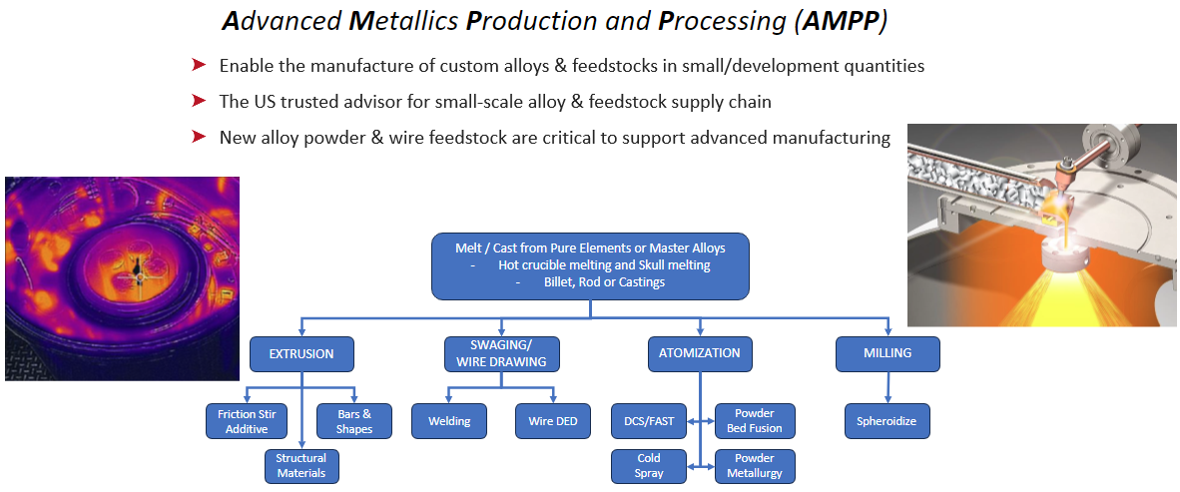
LIFT Advanced Metallics Production and Processing
Capability Available to LIFT Members

Slide 9
LIFT Ecosystem Accelerator Program (LEAP 2023)
Project Submission Form

Slide 10
Proposal #:
LIFT Ecosystem Accelerator Program
Project #:
Instructions
Complete the attached forms to submit your project
Include proposed budget ( Maximum $250,000 from LIFT ) and timeline ( 6 months )
Projects will be evaluated on:
  Technological Merit
  Technology TRL and MRL level
  Program Timing
  Funding Request
  LIFT Member Engagement
  Planned use of LIFT’s High-Bay Equipment.
  Cost Share Commitment
Submit completed forms https://lift.technology/project-calls/

Slide 11
Proposal #:
LIFT Ecosystem Accelerator Program
Project #:
Project Data
Submission Date:
Industry:
Proposal Number:
Proprietary?
Member Level
Company:
LIFT Member?
Title:
Goal:
Project Leader:
Leader Email:
Leader Phone:

Slide 12
Proposal #:
LIFT Ecosystem Accelerator Program
Project #:
Partners and Key Personnel
List all partners that will participate including Suppliers and Academic Institutes
  Indicate Principle Investigator (only one PI allowed)
  % responsibility for each partner
  Provide principle contact for each partner
Approval
CTO: Noel Mack
CFO: Victor Claudio
CEO & Executive Director: Nigel Francis

Slide 13
Proposal #:
LIFT Ecosystem Accelerator Program
Project #:
Abstract
Summary overview of the proposed project

Slide 14
Proposal #:
LIFT Ecosystem Accelerator Program
Project #:
Proposed Budget
Workshare and Funding breakdown of project
Organization | Member | % Effort | Cost $’s | Cost %
Organization Name A (PI) | Platinum
Organization Name B | Gold
Organization Name C | Silver
Organization Name D | Academic
LIFT High-Bay | LIFT
Total Project Value (TPV $) |  | 100% | $xxx,xxx | 100%
Project Funding
LEAP Project Funding from LIFT
Member Cost Share (CS $)
Total Project Value (TPV $) | $xxx,xxx
Estimated Total Project Value: (TPV $) Estimated Total Cost Share: (CS $)

Slide 15
Proposal #:
LIFT Ecosystem Accelerator Program
Project #:
Identification of the Problem
Give background that identifies the problem
Deliverables
Define the measures or other indicators that will be used to:
  Judge the success of the deliverables
  Identify ways to improve performance at a later date

Slide 16
Proposal #:
LIFT Ecosystem Accelerator Program
Project #:
Proposed Work Justification
Does the proposed work benefit a single company or will it offer improved techniques or technology to American companies? Explain
Is patentable IP anticipated? Will background IP be disclosed to LIFT during the project?
What gives the proposed work novel attributes?
Include as appropriate:
  Theory
  Relevant previous experimental results
  Theoretical modeling of experimental results
  Implications of work completed to date
  Identification of critical needs
Add additional citations, photos and/or pages as needed

Slide 17
Proposal #:
LIFT Ecosystem Accelerator Program
Project #:
Current and Future Technical State
Define current TRL and MRL Level (See Appendix A)
Define and explain TRL and MRL at conclusion of project

Slide 18
Proposal #:
LIFT Ecosystem Accelerator Program
Project #:
Problem Scope
State what will be within the team’s working boundaries and what the team will not be working on.

Slide 19
Proposal #:
LIFT Ecosystem Accelerator Program
Project #:
Technical Approach/Solution
State the proposed solution
  List specific tasks
  Include Graphs, photos, examples, etc.

Slide 20
Proposal #:
LIFT Ecosystem Accelerator Program
Project #:
Project Schedule
High level Gantt chart showing tasks & dependencies
Suggested TimeLine
Month 1
Month 2
Month 3
Month 4
Month 5
Month 6
Design/Simulation
Simulation
Design Proto Tools
Build Proto Tools
Assembly/Try
Testing /Validation

Slide 21
Proposal #:
LIFT Ecosystem Accelerator Program
Project #:
Proposed Work at LIFT and Anticipated Environmental Impact ​
For project work planned at LIFT:
Identify potential adverse environmental impacts from the completion of this work
The use of hazardous chemicals or other materials.
  Provide SDS sheets for proposed chemicals and materials brought into LIFT
Possible emissions of toxic substances due to the operation of a process
If there are no adverse impacts show this page as “N/A”

Slide 22
Thank you!

Slide 23
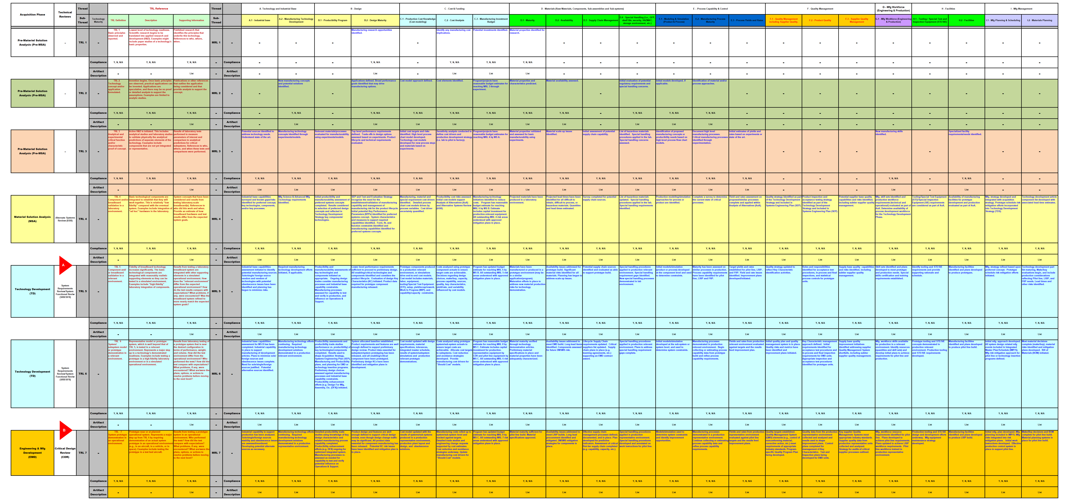
Proposal #:
Project #:
Current Technical State
Appendix A

