Slide 1
LIFT Ecosystem Accelerator Program (LEAP 2023)
Project Call
Rev. 1
DEV 6/23/2023

Slide 2

Instructions
Complete the attached forms to submit your project
Include proposed budget (Maximum $200,000 from LIFT) and timeline (6 months)
Projects will be evaluated on:
  Technological Merit
  Technology MRL level
  Program Timing
  Funding Requirement
  LIFT Member Engagement
  Planned use of LIFT’s High-Bay Equipment
  Cost Share Commitment
Submit completed forms to https://lift.technology/project-calls/
Click to register for LIFT’s Q&A Sessions:
  WATCH Q&A Session #1
  WATCH Q&A Session #2

Slide 3
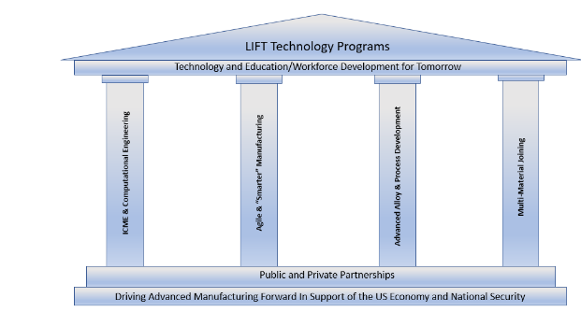
LEAP 2023
Project Summary
Open to all LIFT members
  Awardee must be a LIFT Bronze member or higher tier
  All project consortium members must be a LIFT member in good standing for award
  Non-members may submit proposals but must join membership to minimum Bronze tier upon selection
Subject(s) must be aligned with the four LIFT Technology Pillars
Subject(s) defined by six (6) topics

Slide 4
LEAP 2023
Project Timing
Proposal Deadline: Aug 28, 2023
Initial Project Selection: Sep 2023
Subawards contracting: Starting Sep after initial project selection
Projects must be completed by May 31, 2024
  Max six (6) month project duration
  Final report due Jul 1, 2024
Debrief to non-awardees: Dec 2023
  Including discussion regarding further developing project ideas into “white papers” for submission in future proposals

Slide 5
LEAP 2023
Project Funding
  Max $200,000 LIFT contribution per project
  Minimum industry cost-share 20% of Total Project Value
  Cost-share (recommended at 1:1) is strongly considered in project selection
  Award will be cost reimbursable – no fee
  Not to Exceed amount of LIFT award
  To be billed on a monthly basis as costs are incurred
  Fully burdened cost proposal required at submission deadline

Slide 6
LEAP 2023
Decision Criteria
Technological Merit
  Aligned with project topics
  Aligned with LIFT pillars
Technology MRL
  MRL 4-7 Only (below 4 and above 7 disqualified)
  Moves the TRL/MRL by 1 or 2 points
Funding requirement
Cost share commitment
  Including services, materials etc.
LIFT member engagement
  Lift Bronze member or higher
  LIFT Ecosystem involvement
Use of LIFT High-Bay and Equipment
  https://lift.technology/facilities/

Slide 7

LEAP 2023
Topics for LEAP 2023 Project Call
High Throughput Alloy Synthesis And Test
  Automated Metallography And Analysis
  Chemical Analysis
Hypersonic Performance Testing
  Hot Structure
  Aerothermodynamics
Virtual Representation Of Materials In Extreme Environments
  Crack Growth In Homogenous Materials
  Gun-barrel Interactions
  Ballistic Impact
  Hypersonics
Digital Augmentation Of Manufacturing Processes
  In-situ Monitoring
  Process Modeling
    DCS
    Atomizing
High Temperature Materials
  MMCs, Ceramics, CMCs, Metallics
  ICME For Ceramics And CMCs (Chemistry, Process, Structure, Performance)
  Joining
  Cost Effective, Scalable, Refractory Metal Processing
    Hydride – Dehydride
    Alloying
Design Of Materials
  Design For Materials Recovery
  Critical Element Reclamation
  Displacement/Replacement Of Critical Materials
  Battlefield Foraged Material Re-use
  Graded Materials Property And Performance
  Supply Chain Modeling
    Lifecycle, Risk, Cost

Slide 8
LIFT Ecosystem Accelerator Program (LEAP 2023)
Project Submission Form

Slide 9
Instructions
Complete the attached forms to submit your project
Include proposed budget ( Maximum $200,000 from LIFT ) and timeline ( 6 months )
Projects will be evaluated on:
  Technological Merit
  Technology MRL level
  Program Timing
  Funding Requirement
  LIFT Member Engagement
  Planned use of LIFT’s High-Bay Equipment.
  Cost Share Commitment
Submit completed forms https://lift.technology/project-calls/

Slide 10
Project Data
Submission Date:
Industry:
Proposal Number:
Proprietary?
Member Level
Company:
LIFT Member?
Title:
Goal:
Project Leader:
Leader Email:
Leader Phone:

Slide 11
Partners and Key Personnel
List all partners that will participate including Suppliers and Academic Institutes
  Indicate Principle Investigator (only one PI allowed)
  % responsibility for each partner
  Provide principle contact for each partner
Approval
CTO: Noel Mack
CFO: Victor Claudio
CEO & Executive Director: Nigel Francis

Slide 12
Abstract
Summary overview of the proposed project

Slide 13
Proposed Budget
Workshare and Funding breakdown of project
Organization | Member | % Effort | Cost $’s | Cost %
Organization Name A (PI) | Platinum
Organization Name B | Gold
Organization Name C | Silver
Organization Name D | Bronze
Organization Name E | Academic
LIFT High-Bay | LIFT
Total Project Value (TPV $) |  | 100% | $xxx,xxx | 100%
Project Funding
LEAP Project Funding from LIFT
Member Cost Share (CS $)
Total Project Value (TPV $) | $xxx,xxx
Estimated Total Project Value: (TPV $) Estimated Total Cost Share: (CS $)

Slide 14
Identification of the Problem
Give background that identifies the problem
Deliverables
Define the measures or other indicators that will be used to:
  Judge the success of the deliverables
  Identify ways to improve performance at a later date

Slide 15
Proposed Work Justification
Does the proposed work benefit a single company or will it offer improved techniques or technology to American companies? Explain
Is patentable IP anticipated? Will background IP be disclosed to LIFT during the project?
What gives the proposed work novel attributes?
Include as appropriate:
  Theory
  Relevant previous experimental results
  Theoretical modeling of experimental results
  Implications of work completed to date
  Identification of critical needs
Add additional citations, photos and/or pages as needed

Slide 16
Current and Future Technical State
Define current TRL/MRL Level (See Appendix A)
Define and explain TRL/MRL at conclusion of project

Slide 17
Problem Scope
State what will be within the team’s working boundaries and what the team will not be working on.

Slide 18
Technical Approach/Solution
State the proposed solution
  List specific tasks
  Include Graphs, photos, examples, etc.

Slide 19
Project Schedule
High level Gantt chart showing tasks & dependencies
Suggested TimeLine
Month 1
Month 2
Month 3
Month 4
Month 5
Month 6
Design/Simulation
Simulation
Design Proto Tools
Build Proto Tools
Assembly/Try
Testing /Validation

Slide 20
Proposed Work at LIFT and Anticipated Environmental Impact ​
For project work planned at LIFT:
Identify potential adverse environmental impacts from the completion of this work
The use of hazardous chemicals or other materials.
  Provide SDS sheets for proposed chemicals and materials brought into LIFT
Possible emissions of toxic substances due to the operation of a process
If there are no adverse impacts show this page as “N/A”

Slide 21


THANK YOU!
Follow us on LinkedIn at LIFT
LIFT:
(313) 309-9003
communications@almmii.org
www.lift.technology
Follow us on Twitter @NewsFromLIFT

Slide 22
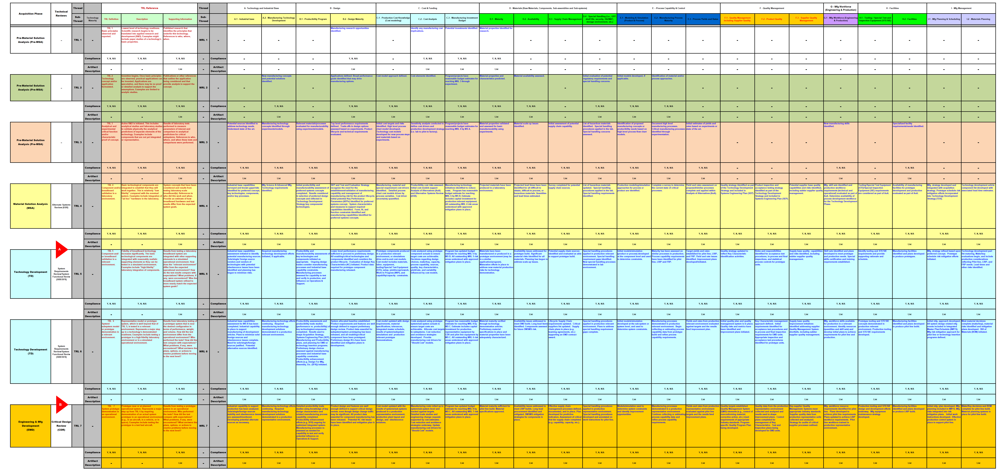
Proposal #:
Project #:
Current Technical State
Appendix A

