Slide 1
U LIFT Project Submission Forms
Rev. 3
ASH 10/19/2021

Slide 2
U LIFT Project Instructions
Instructions
Complete the attached forms to submit your project. Only the slides in this template will be considered. Do not add extra slides. Extra content will not be considered.
Include proposed budget (Maximum $50,000 per project from LIFT with minimum 25% cost share of sponsored funding) and timeline (9 months)
Winning submissions will be required to join LIFT at $1,000 membership fee
Projects will be evaluated on:
  Technological Merit
  Technology Readiness Level/Manufacturing Readiness Level
  Ability to meet program timing & proposed budget including cost share
  LIFT Member Engagement
There is no limit to the number of proposals that can be submitted by a single University
Submit completed forms at https://lift.technology/project-calls/
LIFT membership not required for proposal submission but is required for receipt of funds

Slide 3
Proposal #:
U LIFT
Project #:
Project Data
Submission Date:
Industry:
Proposal Number:
Proprietary?
University:
LIFT Member?
Title:
Goal:
Project Leader:
Leader Email:
Leader Phone:

Slide 4
Proposal #:
U LIFT
Project #:
Abstract
Partners and Key Personnel
Summary overview of the proposed project
List all partners that will participate including suppliers, Small Medium Enterprises (SME’s), Academic Institutes
  Estimate % responsibility for each partner
  Provide principle contact for each partner
  Indicate status of LIFT membership
Starting MRL/TRL: [Insert # Here]
Ending MRL/TRL: [Insert # Here]
Approval
VP of Tech: Noel Mack
CTO: Hadrian Rori

Slide 5
Proposal #:
U LIFT
Project #:
Problem Scope
Identify the problem to be solved
Provide relevant background information
Who benefits from solving this problem?
State what will be within the team’s working boundaries and what the team will not be working on.

Slide 6
Proposal #:
U LIFT
Project #:
Technical Approach/Solution
State the proposed solution
  List specific tasks
  Include Graphs, photos, examples, etc.
What makes the proposed work novel?
Does the proposed work benefit a single company or will the solution be offered industry wide?
IP generation anticipated? Will background IP be shared with LIFT during the project?

Slide 7
Proposal #:
U LIFT
Project #:
Deliverables & Project Schedule
High level Gantt chart showing tasks & dependencies
Define the measures or other indicators that will be used to:
  Judge the success of the deliverables
  Identify ways to improve performance at a later date

Slide 8
Proposal #:
U LIFT
Project #:
Budget
Cost share of sponsored funding is one of the decision criteria (minimum 25%)
Budget breakdown must include details of the cost share.

Slide 9
Proposal #:
U LIFT
Project #:
Anticipated Environmental Impact of Proposed Work
For project work planned at LIFT:
Identify potential adverse environmental impacts from the completion of this work
The use of hazardous chemicals or other materials.
  Provide SDS sheets for proposed chemicals and materials brought into LIFT
Possible emissions of toxic substances due to the operation of a process
If there are no adverse impacts show this page as “N/A”

Slide 10
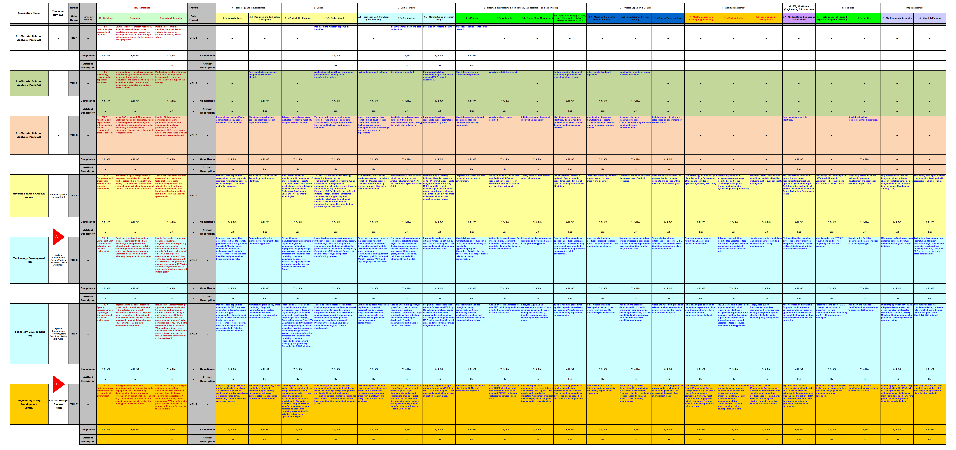
Proposal #:
U LIFT
Project #:
Current Technical State
Appendix A

