Slide 1
LIFT Hypersonic Challenge Project Submission Form
Rev. 8

Slide 2
LIFT Hypersonic Challenge
Instructions
Complete the attached forms to submit your project
Include proposed budget and timing milestones aligned with Challenge Call parameters.
Projects will be evaluated on:
Technological Merit
Technology MRL level
Program Timing
Funding Requirement
LIFT Member Engagement
Submit completed forms to LIFT.Technology/project-calls

Slide 3
LIFT Proposal #:
LIFT Project #:
LIFT Hypersonic Challenge
Project Data
Submission Date:
Industry:
Proposal Number:
Proprietary?
Member Level
Company:
LIFT Member?
Yes/No
Challenge Topic:
Title:
Goal:
Project Leader:
Leader Email:
Leader Phone:

Slide 4
LIFT Proposal #:
LIFT Project #:
LIFT Hypersonic Challenge
Partners and Key Personnel
List all partners that will participate including Suppliers and Academic Institutes
% responsibility for each partner
Provide principle contact for each partner
Approval
CTO: Hadrian Rori
CEO & Executive Director: Nigel Francis

Slide 5
LIFT Proposal #:
LIFT Project #:
LIFT Hypersonic Challenge
Abstract
Summary overview of the proposed project

Slide 6
LIFT Proposal #:
LIFT Project #:
LIFT Hypersonic Challenge
Proposed Budget
Workshare and Funding breakdown of project
Organization | Member | % Effort | Cost $’s | Cost %
Organization Name A (PI) | Platinum
Organization Name B | Gold
Organization Name C | Silver
Organization Name D | Bronze
Organization Name E
Organization Name F
Total Project Value (TPV $) |  | 100% | $xxx,xxx | 100%
Project Funding
LIFT Hypersonics Challenge | Max $1.0M
Member Cost Share (CS $)
Total Project Value (TPV $) | $xxx,xxx
Estimated Total Project Value: (TPV $) Estimated Total Cost Share: (CS $)

Slide 7
LIFT Proposal #:
LIFT Project #:
LIFT Hypersonic Challenge
Identification of the Problem
Give background that identifies the problem
Deliverables
Define the measures or other indicators that will be used to:
Judge the success of the deliverables
Identify ways to improve performance at a later date

Slide 8
LIFT Proposal #:
LIFT Project #:
LIFT Hypersonic Challenge
Proposed Work Justification
Does the proposed work benefit a single company or will it offer improved techniques or technology to American companies? Explain
Is patentable IP anticipated? Will background IP be disclosed to LIFT during the project?
What gives the proposed work novel attributes?
Include as appropriate:
Theory
Relevant previous experimental results
Theoretical modeling of experimental results
Implications of work completed to date
Identification of critical needs
Add additional citations, photos and/or pages as needed

Slide 9
LIFT Proposal #:
LIFT Project #:
LIFT Hypersonic Challenge
Current and Future Technical State
Define current TRL/MRL Level See Appendix A and DOCENT Manufacturing Readiness Levels Tool (dodmrl.com)
Define and explain TRL/MRL at conclusion of project

Slide 10
LIFT Proposal #:
LIFT Project #:
LIFT Hypersonic Challenge
Problem Scope
State what will be within the team’s working boundaries and what the team will not be working on.

Slide 11
LIFT Proposal #:
LIFT Project #:
LIFT Hypersonic Challenge
Technical Approach/Solution
State the proposed solution
List specific tasks
Include Graphs, photos, examples, etc.

Slide 12
LIFT Proposal #:
LIFT Project #:
LIFT Hypersonic Challenge
Project Schedule
High level Gantt chart showing tasks & dependencies
TimeLine
Qtr 1
Qtr 2
Qtr 3
Qtr 4
Qtr 5
Design
Simulation
Proof of Concept
Concept Demo
Final Report

Slide 13
LIFT Proposal #:
LIFT Project #:
LIFT Hypersonic Challenge
Proposed Work at LIFT and Anticipated Environmental Impact
For project work planned at LIFT:
Scope / tasks and deliverables
Identify potential adverse environmental impacts from the completion of this work
The use of hazardous chemicals or other materials.
Provide SDS sheets for proposed chemicals and materials brought into LIFT
Possible emissions of toxic substances due to the operation of a process
If there are no adverse impacts show this page as “N/A”

Slide 14
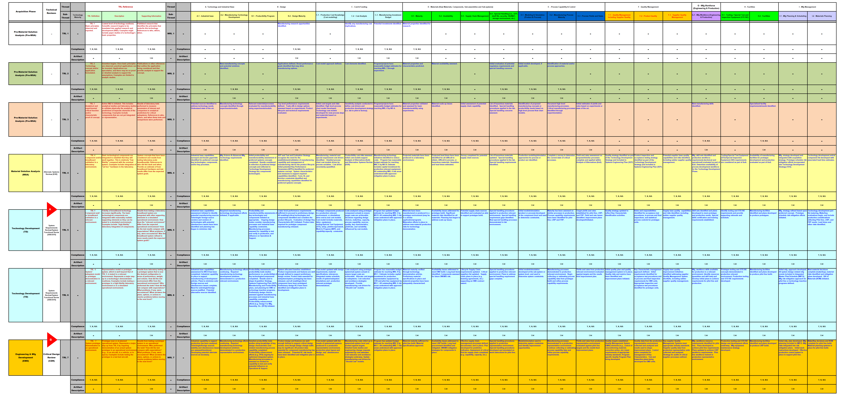
LIFT Proposal #:
LIFT Project #:
LIFT Hypersonic Challenge
Current Technical State
Appendix A

Slide 15


THANK YOU!
Follow us on LinkedIn at LIFT
LIFT:
(313) 309-9003
communications@almmii.org
www.lift.technology
Follow us on Twitter @NewsFromLIFT

